Slide 1
Charity App
Dhanvi Mange - 119A3013
Divyalaxmi Thiruganan -119A3015
Mahitha Vaidyanathan - 119A3054
Sai Pavani Lanka - 119A3056
Guide:- Mrs. Masooda Modak

Slide 2
Introduction
This Charity App aims to help users with their charitable donations by giving them a platform where they can find trustworthy charities and easily donate to them.
This application is fully categorized with all types of charitable acts i.e. animal charity, food charity, women charity, clothes charity, etc. Users who donate to charity can get all information regarding specific charity type.
It provides an overview of various charity aid foundations. The users of this charity app may also view the donations made by them.

Slide 3
Project Idea
The project is about designing an on-line donation management system to enable every person/household to donate anything easily.
As many charity organisations are making a big effort to collect donations. It is quite costly and inefficient for charity organisations to do on-door envelope distribution and collection.
It helps charity organisations to provide better management of their resources and only make necessary door to door collections.

Slide 4
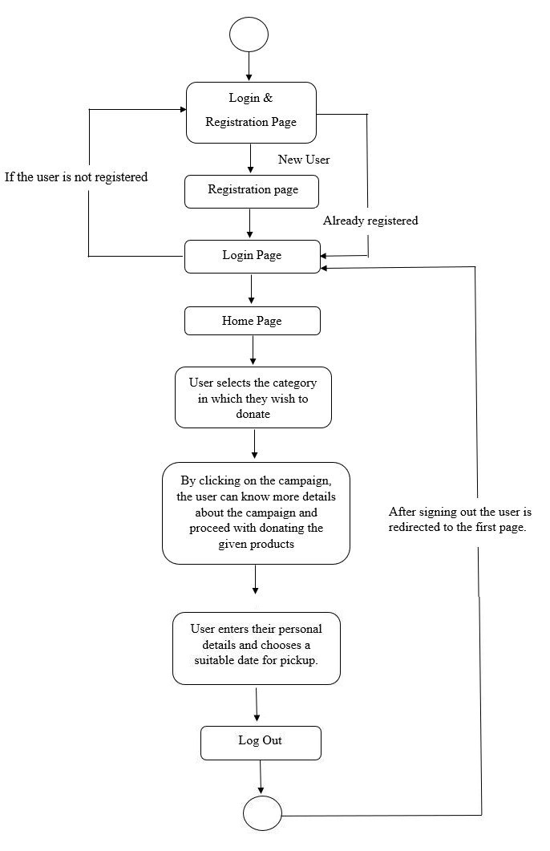
Flow Diagram

Slide 5
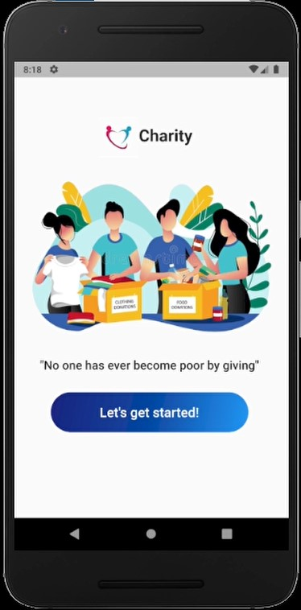
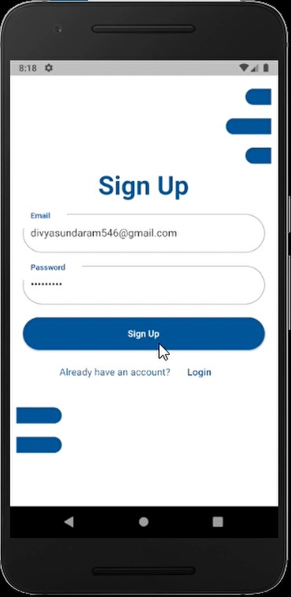
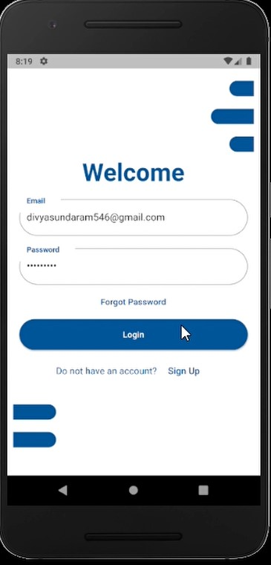
Experiment Results

Slide 6
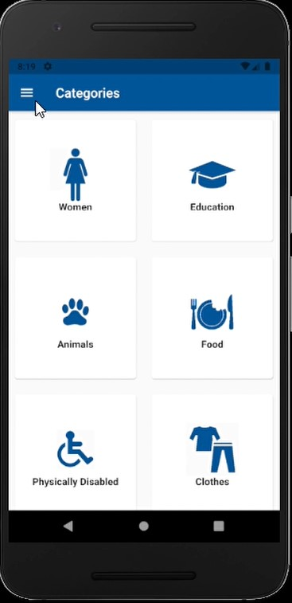
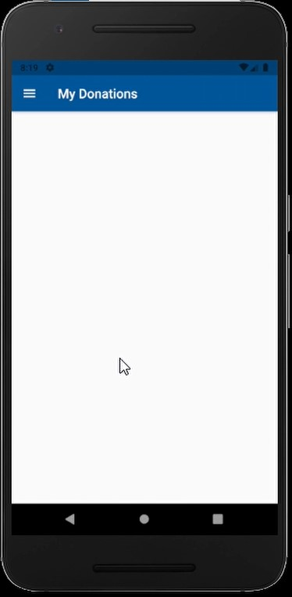
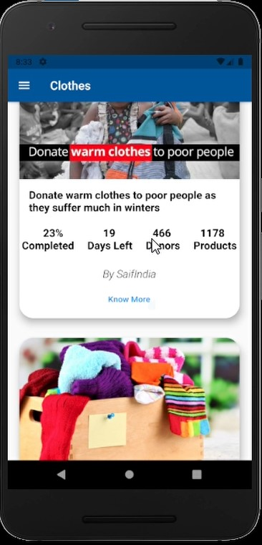
Experiment Results

Slide 7
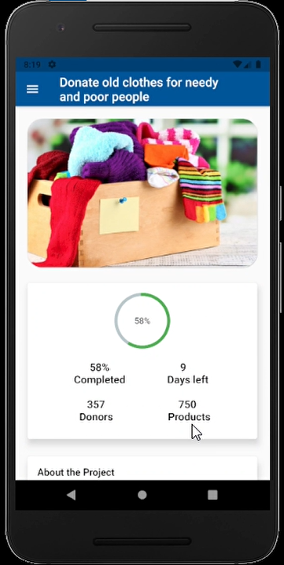
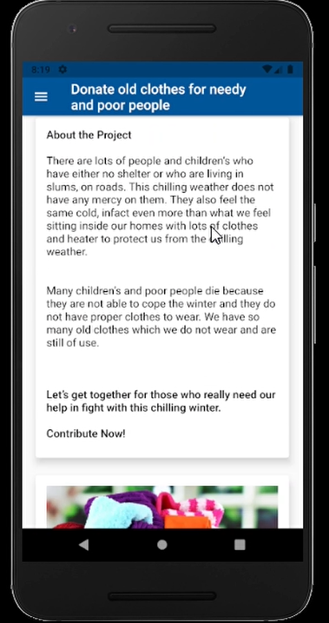
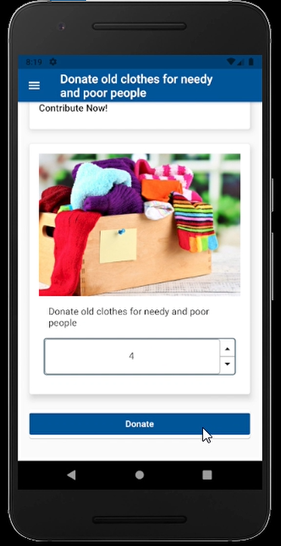
Experiment Results

Slide 8
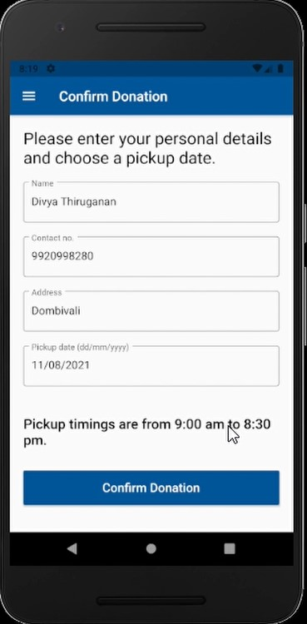
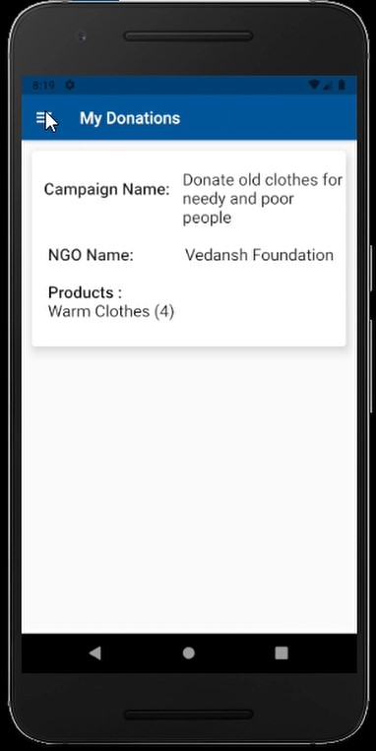
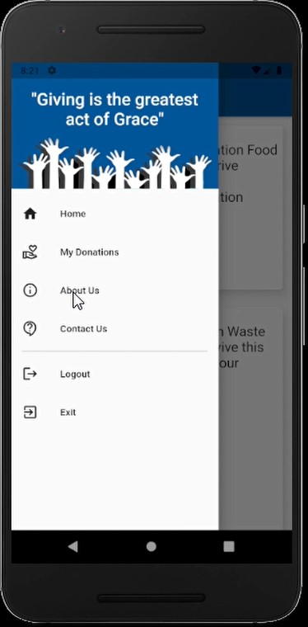
Experiment Results

Slide 9
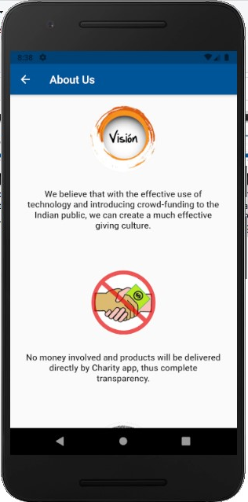
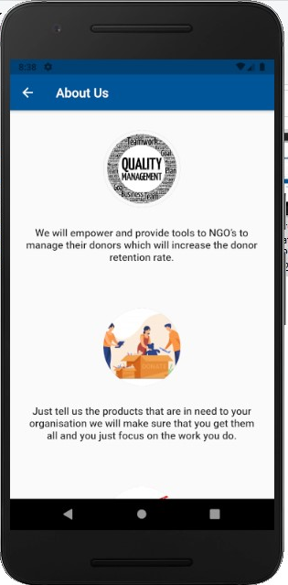
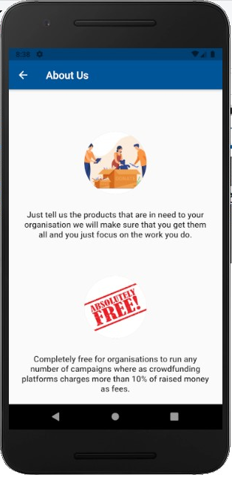
Experiment Results

Slide 10
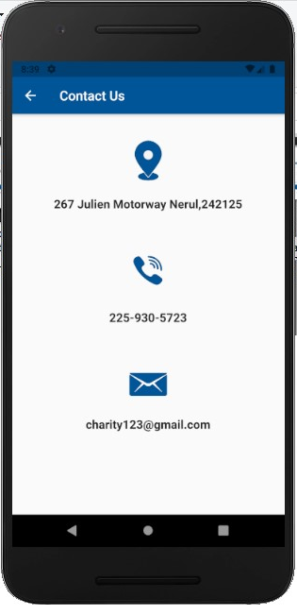
Experiment Results

Slide 11
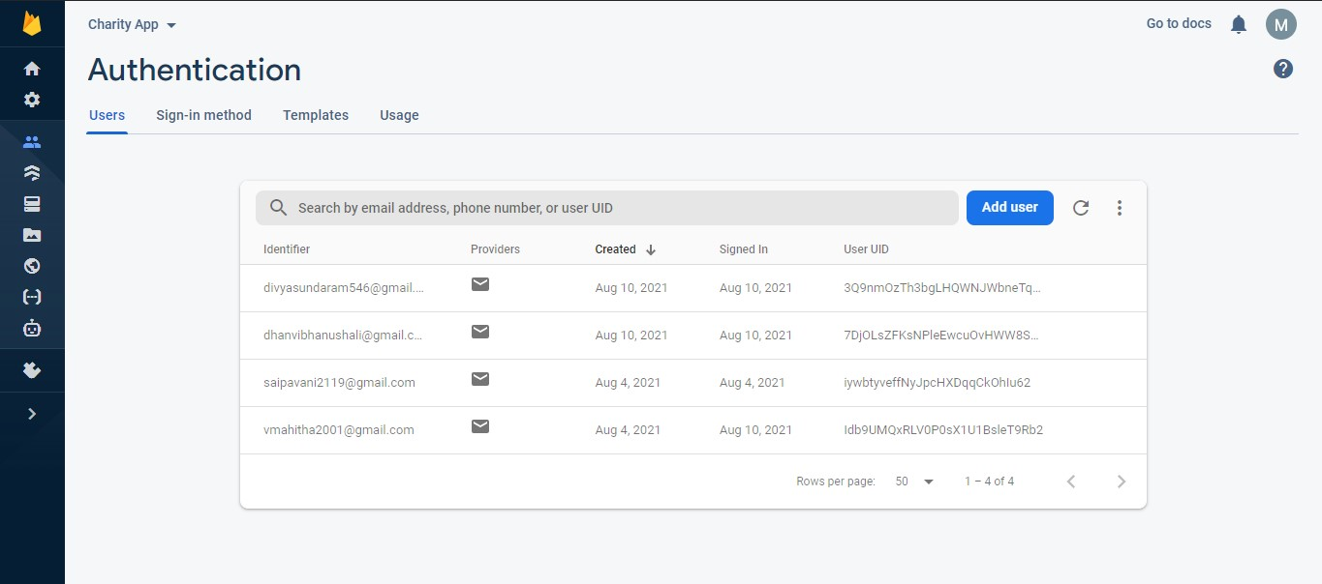
Experiment Results

Slide 12
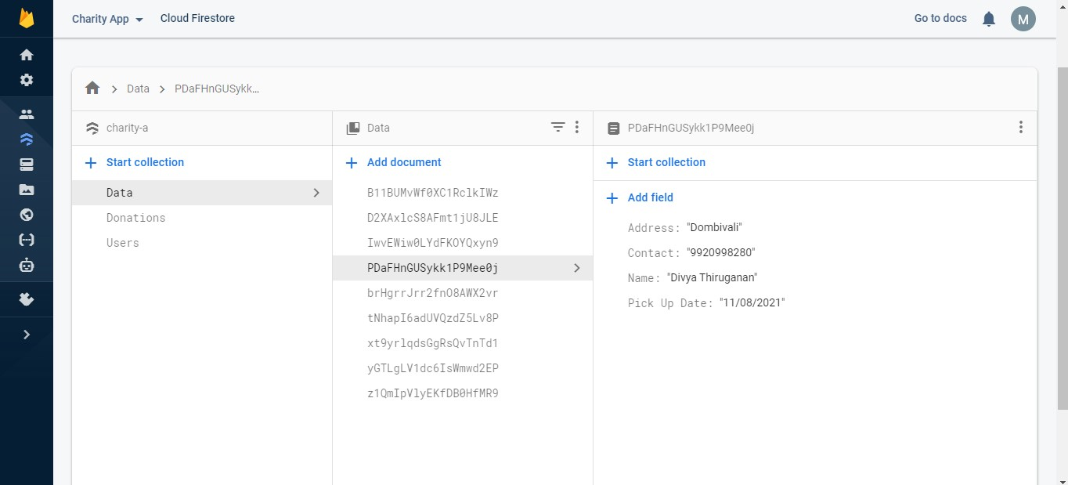
Experiment Results

Slide 13
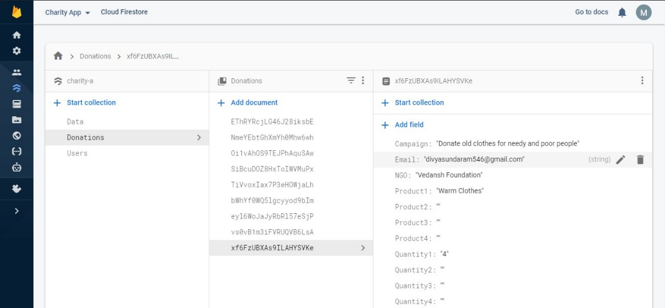
Experiment Results

Slide 14
Software Requirements
Operating System: Windows 10.
Programming Languages: Flutter & Firebase
IDE: PyCharm.
Web Browser: Google Chrome

Slide 15
Applications
The idea of the app is letting users donate as much as they can to someone in need.
Collect donor data.
Foster a sense of community.
Provide interactive features for users.
Make donors feel safe.

Slide 16
Conclusion
Through this app we are creating a link between the charities and donors.
Help charities (large or small) to gain more donations.
Reduce door to door collections.
To make the process more efficient and less time consuming and easier to access.

Slide 17
Thank you

